Slide 1

Hobletts Manor Junior School
Inspiring proud, confident lifelong learners

Slide 2
Our Vision:
To inspire proud, confident lifelong learners to achieve success for all
Our mission:
Together create opportunity and challenge expectation to develop successful, resilient and aspirational children within an inclusive and supportive environment.
We aim to be:
An all-inclusive school where all members of the school community have equal access to learning opportunities and enjoy growing, learning and achieving together.
A caring school that welcomes everybody and recognises and celebrates British Values and diversity, tolerance and respect.
A school with high expectations committed to supporting and challenging each learner to be the best they can be.
A school that aims to inspire, through the delivery of an engaging and enriched curriculum.
A school where all learners believe in themselves and each other, view challenge as an opportunity and learning as limitless

Slide 3
OFSTED INSPECTION FINDINGS
Pupils feel happy and safe at Hobletts Manor Junior School. They celebrate diversity and know that they are all special and unique. The school provides an inclusive environment in which pupils flourish. This includes those with special educational needs and/or disabilities (SEND).
Learning is valued and pupils work hard to meet teachers’ high expectations. They learn about resilience and perseverance. They understand how important these qualities will be as they move through life.
There are many opportunities for pupils to thrive outside the classroom. Visits to the theatre, a Hindu temple and London Zoo are among the trips offered. Pupils can sing, dance, act, or play a range of sports at extra-curricular clubs after school, or at lunchtime. The ‘sunshine club’ offers pupils the option of a calmer break time, away from the busy playground.

Slide 4






OUR VALUES

Slide 5
OUR SCHOOL DAY
8.40 Teachers and Parent Partners Available
8.45 Doors Open
8.55 Registers Close
9.25 Whole School Assembly
10.50 Playtime (15 minutes)
12.10 Lunchtime
1.05 Afternoon Lessons Begin
3.15 School Finishes
We place a high priority upon attendance and punctuality. In order to maximise the learning opportunities for your child/children, thank you for ensuring he/she/they arrive at school punctually and regularly. Thank you also for ensuring that family holidays are taken when the school is closed

Slide 6
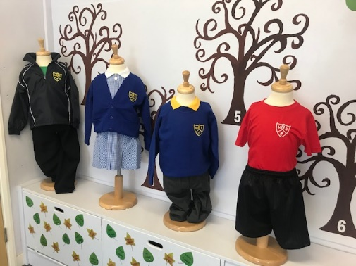
SCHOOL UNIFORM
Mainly same as the Infant and Nursery School but bigger!
White Polo shirts, black or grey trousers or skirts which can be purchased from any uniform provider
Two logo items which are compulsory
* Jumper or Cardigan
* PE Top
Black school shoes for all
PE Uniform to be worn on PE Days
Stud earrings and watches only, no nail varnish/make up
Hair ties – plain and in school colours
All uniform can be purchased online (free delivery to school)
or in store at Beat School Uniform in Watford.
We also have sustainable pre-loved uniform available free of charge.

Slide 7
As a school we……
focus on individuals and their progress holding pupil progress meetings with SLT and individual teachers to ensure that children are on track to make at least good progress and that all needs are being met.
provide additional 1:1 and group work to develop academic and social and emotional skills.
provide regular feedback through marking, setting extra tasks to challenge if they are successful, or to provide more practice if they are not.
Please do not hesitate to talk to us about support or your child.
‘Pupils with SEND and those who are disadvantaged take part in all aspects of school life.’ (Ofsted 2023)

Slide 8
Teaching and Learning
In the Autumn Term our topic will be Through the Ages.
As Historians we will be learning about changes through the Stone Age, Iron Age and Bronze Ages and as Artists we will be looking at Cave Art as well as the work of Paul Klee.
As Scientists we will be investigating plants and as Musicians we will be deepening our understanding of musical notation and of course be involved in our play which we look forward to performing to you. To support this we have booked our first trip to go to Watford Palace Theatre to see ‘A Christmas Carol’ on 9th December.
We will also be looking at both Islam and Christianity in Religious Education, developing our understanding of coding in our Computing lessons and our themes in PSHE are ’Being Me in My World’ and ‘Celebrating Difference.’ As Linguists, we will be learning how to introduce ourselves to others in French based on what time of the day it is.
‘Over a period of time, leaders have developed an ambitious curriculum. It sets out the order of teaching and breaks learning down into small steps. These build towards end points that leaders have identified for each subject and year group.’ (Ofsted 2023)

Slide 9
Home Learning
As parents and carers you have a huge role to play in your child’s learning and we value highly the support you give.
Talking to your child for just two minutes a day can significantly impact on their progress. If ever you would like further ideas on how you can help please do let us know.
Year 3 Home Learning Recommendations
Reading - Minimum recommendation is 5 times weekly. Independent, shared and paired, seven times for the Reading Challenge
Rocking - Minimum recommendation is 5 times weekly, seven times for the Rocking Challenge
Optional Home Learning Tasks/Activities
Notes:
Reading book bands/library visits

Slide 10
Behaviour and Safety
Our school is a place where every person has the right to be themselves, to be included and to learn in a safe and happy environment. Everyone at our school is equal and we treat one another with respect and kindness.
As a school we:
have a positive behaviour policy, reviewed regularly
have an agreed code which helps us to work for excellence. Our code is based upon three key behaviours and is known as our RFR Code. We expect everyone to be:
Respectful
Friendly
Responsible
We look to recognise and celebrate your child’s achievements on a regular basis. We have whole school systems in place including House Points, Weekly Celebration Assemblies, Daily Stars, Friendly Leaves ,Ask Me Why Stickers and Wristbands, Marvellous Me.

Slide 11
Behaviour and Safety
Whilst focusing on positive behaviour, we recognise that at times, children may not follow our code and consequences will follow with opportunities to reflect, restore and repair relationships.
Children will be supported to reflect upon the reasons for their actions as well as the impact upon themselves and others. Opportunities to discuss what they have learnt will focus on risk reduction, and identify a different choice moving forward.
Bullying will not be tolerated and we ask that families come and talk to us if ever they have a concern about relationships.
‘This is a supportive community. Pupils are kind and they behave well. The playground is a harmonious place, thanks to the leadership skills of Year 6 pupils who run activities for their younger peers. Pupils say bullying does not happen and if it did the adults would sort it out. ……Pupils know the routines and expectations of behaviour. (Ofsted 2023)
Notes:
Positive focus – star of the days/maths star/English star/weekly certificates for maths, writing, homework, values/citizenship, lunchtime, attendance. Weekly texts home Termly – attendance/behaviour. Credit Shop

Slide 12
Communication
We are committed to working with you to ensure that your child enjoys and succeeds in our school.
We have:
Weekly newsletters, email, text service, Marvellous Me (Juniper)
Family Consultations (October & March), themed days, visits, visitors
Members of the class team will greet their classes at the start of the day and will bring them to the playground as school closes
Parent Partners are available to talk to before school.
Team pages – updated weekly
  https://www.hoblettsjm.herts.sch.uk/team-pages/azure
  https://www.hoblettsjm.herts.sch.uk/team-pages/amber
If ever you have a question about any aspect of school, please come and talk to us, do not let a query become a concern.

Slide 13
What’s different in Juniors?
There are some main points below we wish to highlight to you when moving from an Infants to a Junior School.
Medical:
Medical Information is NOT automatically transferred. It is really important that the medical forms in your packs are completed and handed into the school office as soon as possible.
Accident reporting and Head Bumps – texts are sent as standard practice
Dietary Requirements – HCL online forms and registration
School Dinners:
Universal Free School Meals end in Year 2. From September 2026 all families in receipt of Universal Credit will be entitled to a free school meal – however you MUST complete the online registration.
School Dinners are currently £3.55 per day
Pupil Premium (Hop into Hobletts) entitlement does not transfer through to Juniors from previous school – please tick the relevant box on your registration forms.

Slide 14
What’s different in Juniors?
Password Collection Scheme:
Passwords for Adults permitted to collect your child – online forms will be circulated in September
If ever you have a question about any aspect of school, please email us anytime - we are available on email throughout the Summer break.
School Dinners:
Payments made in ARBOR on account
Dinner Charges will be deducted when your child orders a meal
Meals are chosen each day at Registration by your child
Meals can be ordered up to 9.15am, therefore if you are running late and would like a meal please call in advance

Slide 15
Committed to the positive involvement in, and enjoyment of, sport & Creativity
Mr Wallis is our PE lead with Mr Porter (PE Assistant) supported by Mr Hall (First Class Fitness) all form part of our specialist team
2 hours of PE per week
PE Uniform – important for competitions
Swimming across Years 3, 4 and 5
Member of School Sports Partnership providing Inter and intra school competitions
Active Mile
After School Clubs – all clubs run until 4.15pm and registration is opened every half term at a cost of £4.75 per week (in half term blocks). A draft schedule for September is :
  Monday : Football – Years 3 & 4 (Supported by Sporting Kids) and Dance (Mrs Green)
  Wednesday : Girls Football – All years
  We also have a number of external groups providing specialist clubs such as
  Wednesday : Martial Arts
  Thursday : Art Club (Kiddle Crafts)
  Friday : Drama Club – All Years (PS Theatre) and Chess Club
Pupils also have the opportunity to join additional programmes such as music and LAMDA which follow a specialist curriculum – more details will follow in due course.
‘Pupils enjoy taking part in a wide range of sports, including more unusual ones, such as lacrosse.’ (Ofsted 2023)

Slide 16
Wraparound Childcare
We offer Breakfast club daily from 7.45am, bookable via the Parent Portal in Arbor. Charges are £6.50 per day for the early 7.30am session and £5.00 per day for 8am – 8.45am. Both sessions include Breakfast and can be booked right up until 7am on the day to cater for those last minute requirements.
Our after school wraparound club is called HUBletts. Places can be reserved with a variety of booking options – either a short session following an afterschool sports club (4.15pm-4.30pm) at a cost of £1.50 or full session (3.15pm-4.30pm) at a cost of £6.50. The sessions include a drink and a snack.
Late after school club until 5.30pm can be booked via Premier Education (this session is in the Infants school with children walked over by Junior Staff) depending on your working requirements.

Slide 17
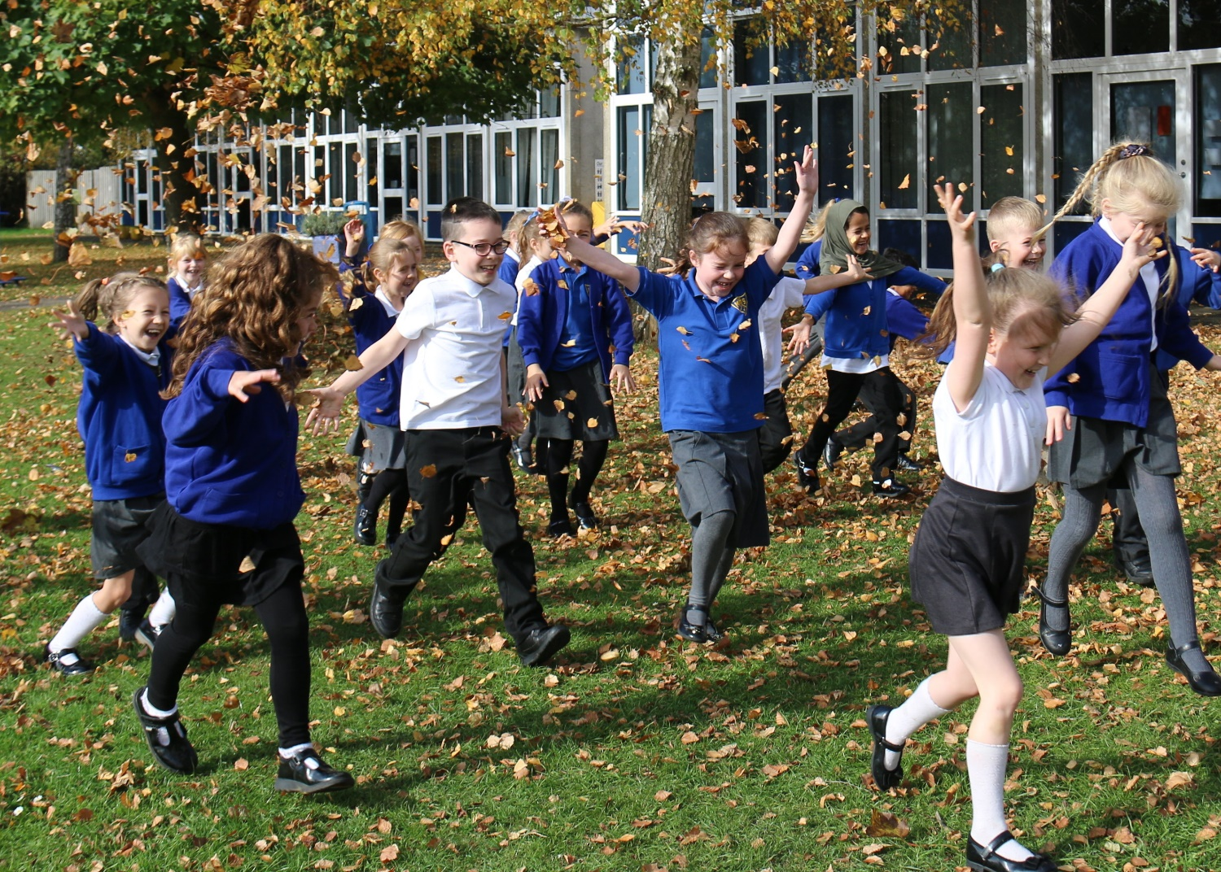
‘Pupils learn that there are no limits to what they can achieve.’ (OFSTED 2023)

