Slide 1

Year 6 Residential September 4th-8th October 2026

Slide 2
Why a residential?
For many this could be their first time staying away from home. The sense of independence and adventure generated can spark excitement and self-belief, developing your child’s resilience and self-confidence.
An opportunity, away from school and home, that encourages children to move out of their perceived comfort zone, to challenge themselves and develop independence
Leadership skills naturally emerge in a residential environment and providing opportunities to problem solve independently and with others.
The experience offers opportunities to broaden and strengthen relationships with their peers across the year group and with the adults who accompany them.
An opportunity to participate in a range of exciting activities that fosters team building
An opportunity to create memories that your child will cherish and an experience that will add to their academic journey.

Slide 3
Potential activities
Dragon Boating
Giant Swing
Raft Building
Climbing
Zip Wire
Fencing
Rifle Shooting
Vertical Challenge
Absailing
https://adventureholidays.pgl.co.uk/camps-for-8-to-11/

Slide 4
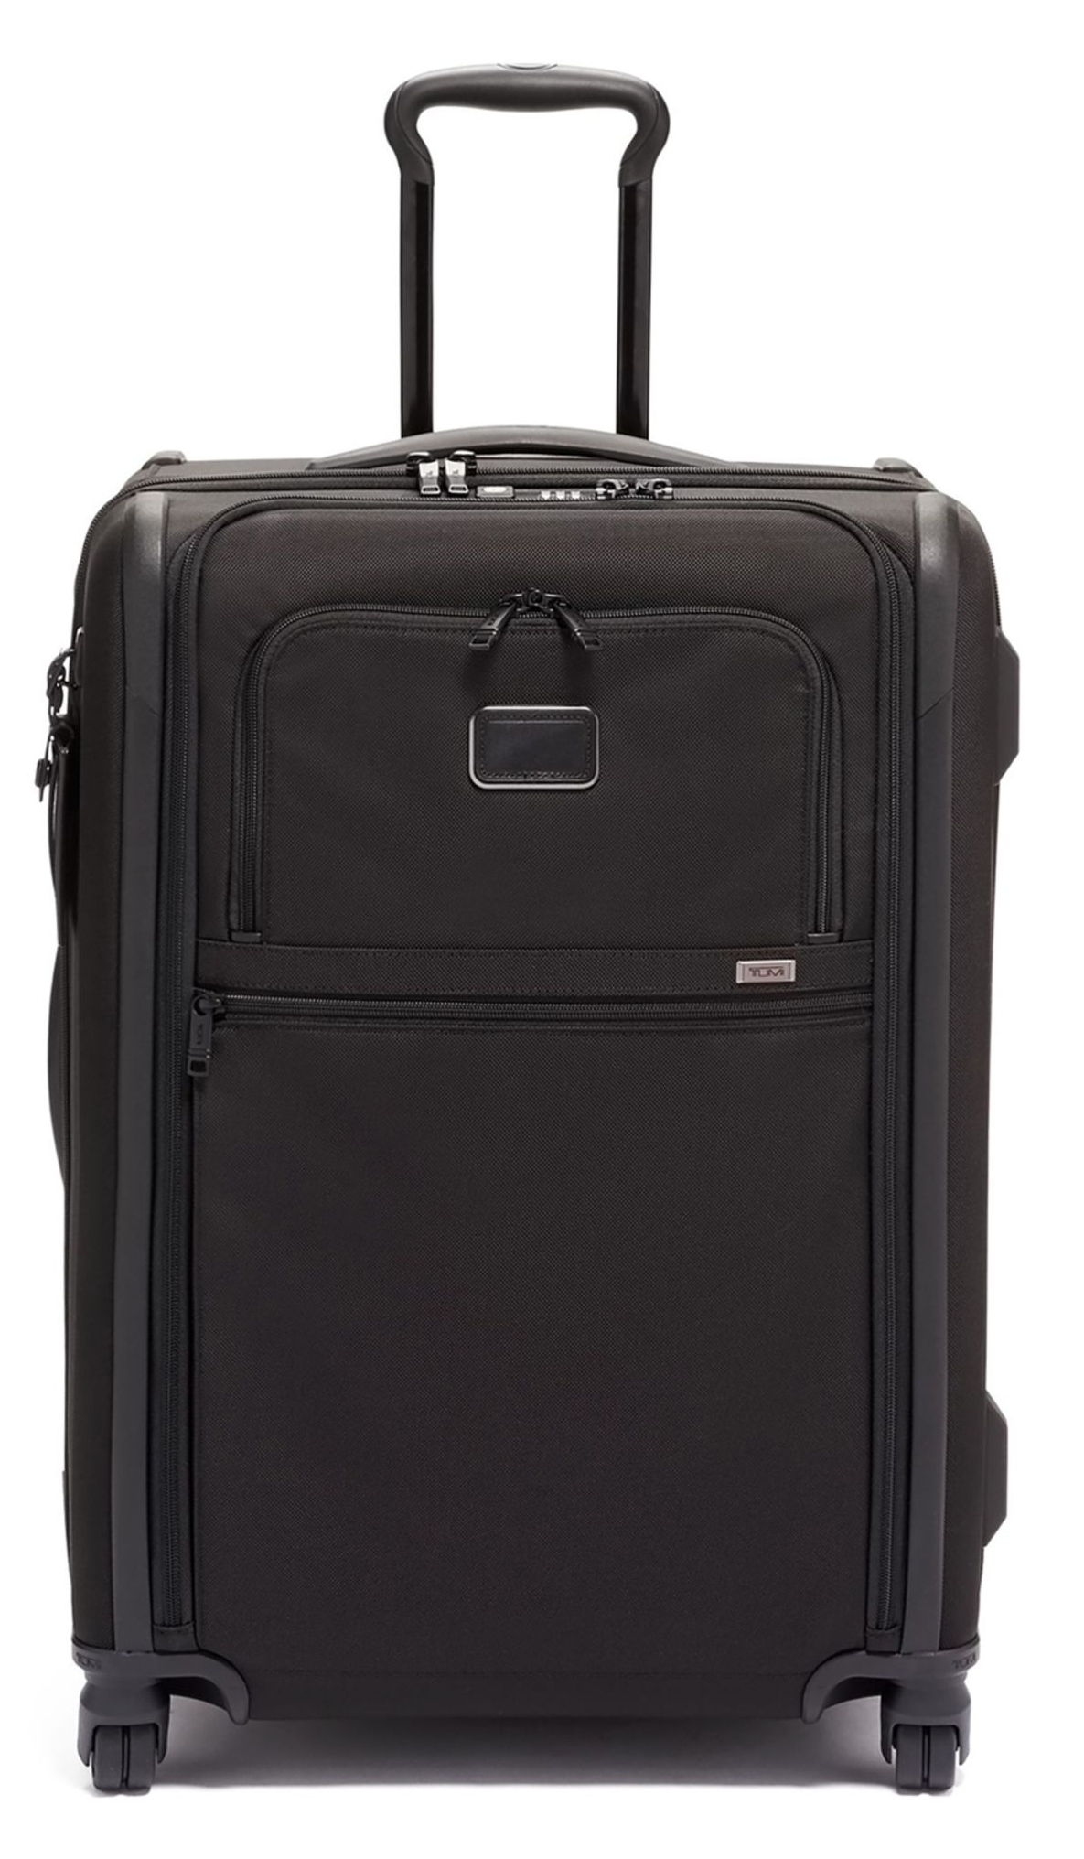
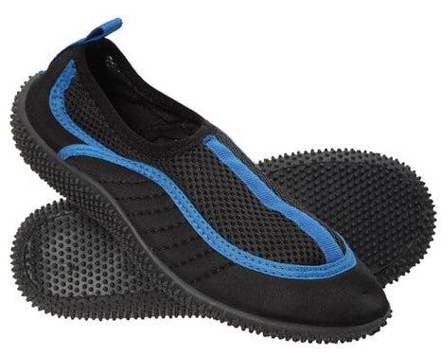
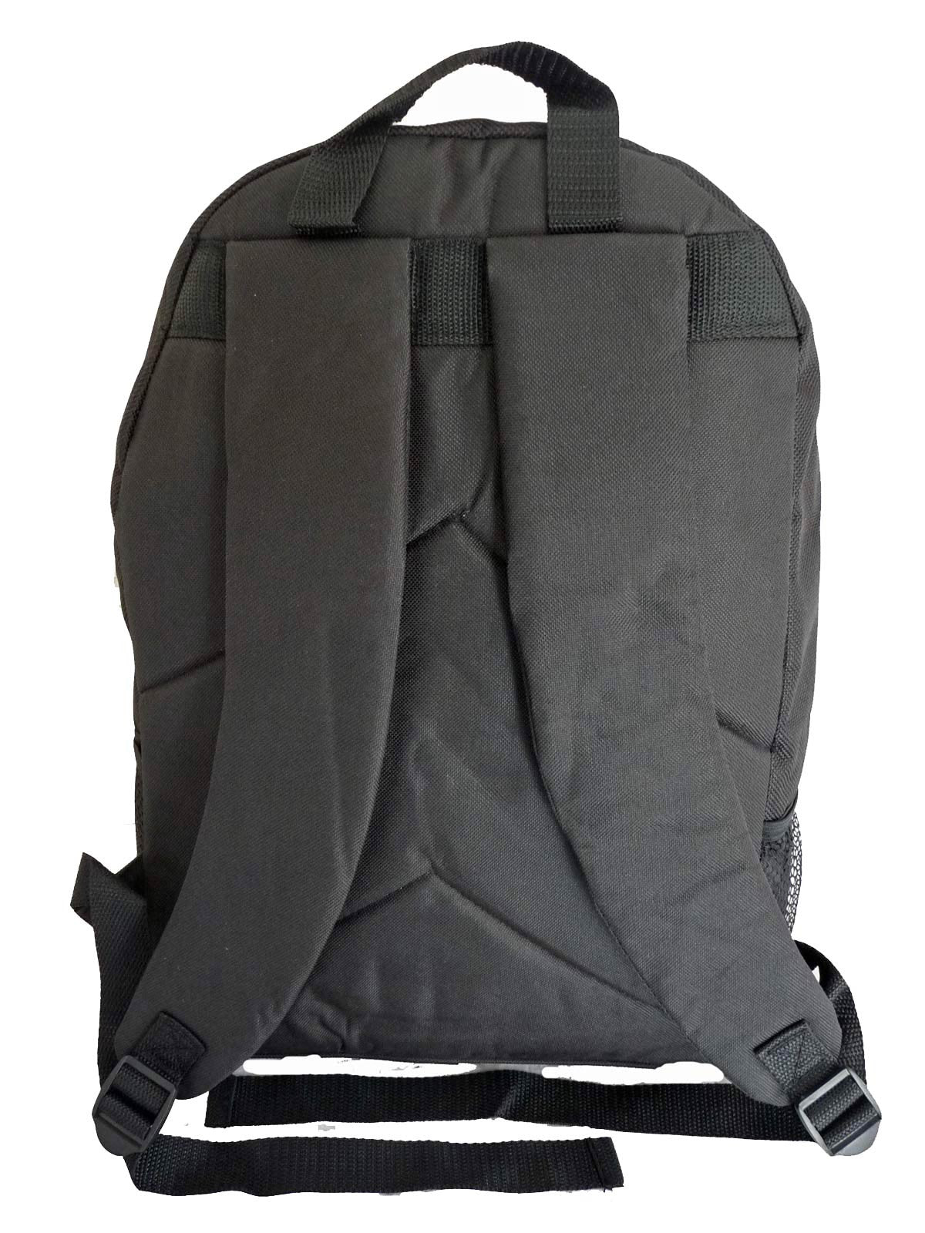
Preparing to go
One suitcase only, big enough to include everything but small enough for your child to transport! A kit list is provided from PGL. We are planning on participating in a number of water based activities, with no drying facilities, old clothes are recommended. No Jeans please but water shoes also may be a beneficial investment! Remember too, swimwear! A PGL kit list can be accessed via this page. Please note, electrical items, mobile phones and aerosols are not permitted.
Black bin liners are great to store wet clothing!
A rucksack (ideally with two shoulder straps) will act as your child’s day bag, containing a waterproof coat/jacket, water bottle, and on the outward journey, a snack. This to remain separate from the suitcase as it will go on the coach with us.
Top Tips! Pack together and for all weathers (sun cream included), label wet and dry clothes (including footwear), have a mix of long sleeve tops, bring lots of black bags.
Remember your sleeping bag, pillow and toothbrush!!

Slide 5
Departure Day – Sunday 4th October 2026
.
We will meet in the school hall between 12.00pm and 12.30pm. Thank you for accessing the school site on foot via Adeyfield Road. The school site is locked immediately after our departure and we do not want you to be locked in!
On arrival hand spending money (maximum £15) and all medicines (clearly labelled) to a member of the school team, this includes travel sickness medication for our return journey. Administration of medicines forms will be required to be completed. This can be done in advance and forms are available from the school office.
Children to have their rucksack separate to the main bag, containing a waterproof (hopefully we will not be needing to wear them!), plastic named water bottle (full) and a snack.
The coach will leave from the bus stop on Adeyfield Road and we will walk there together.
Our coach is due to arrive at 12.45pm in preparation for a 1.00pm departure.

Slide 6
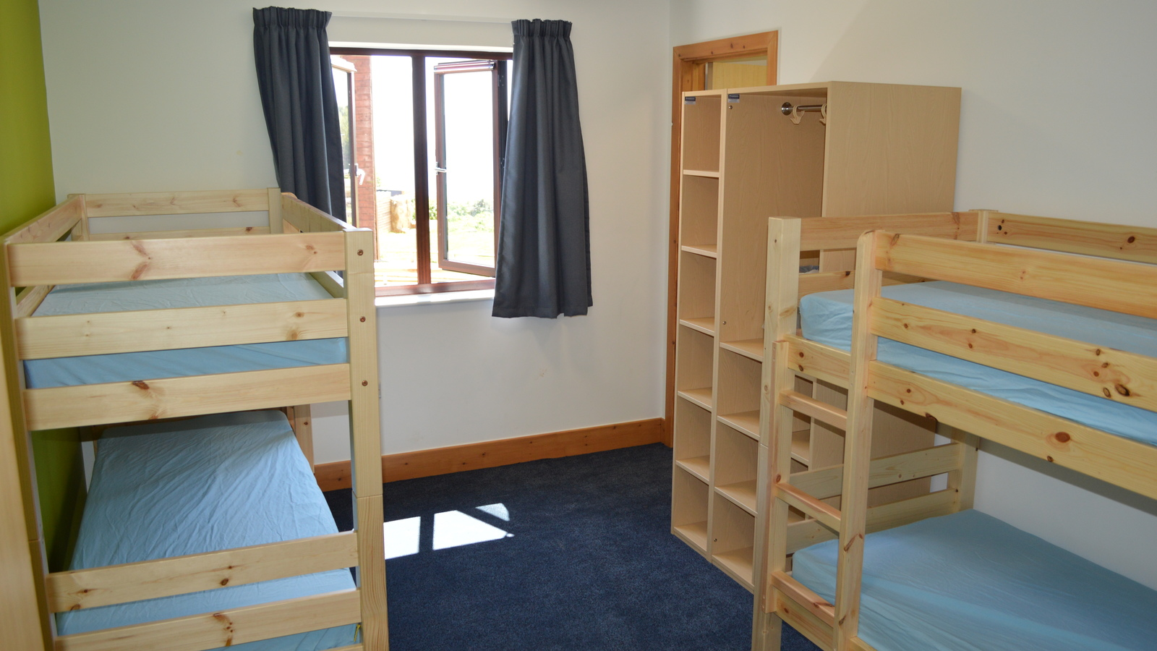
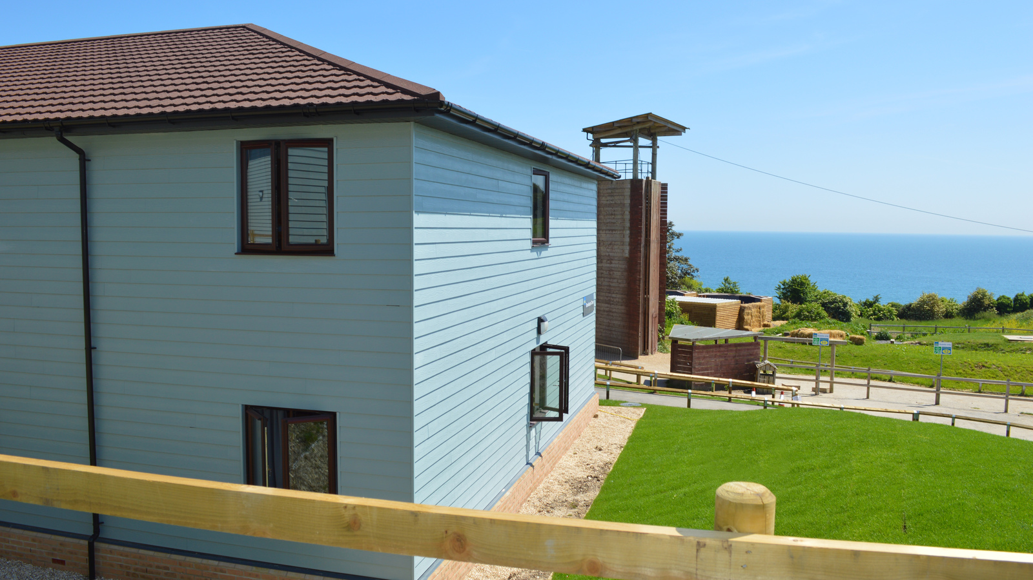
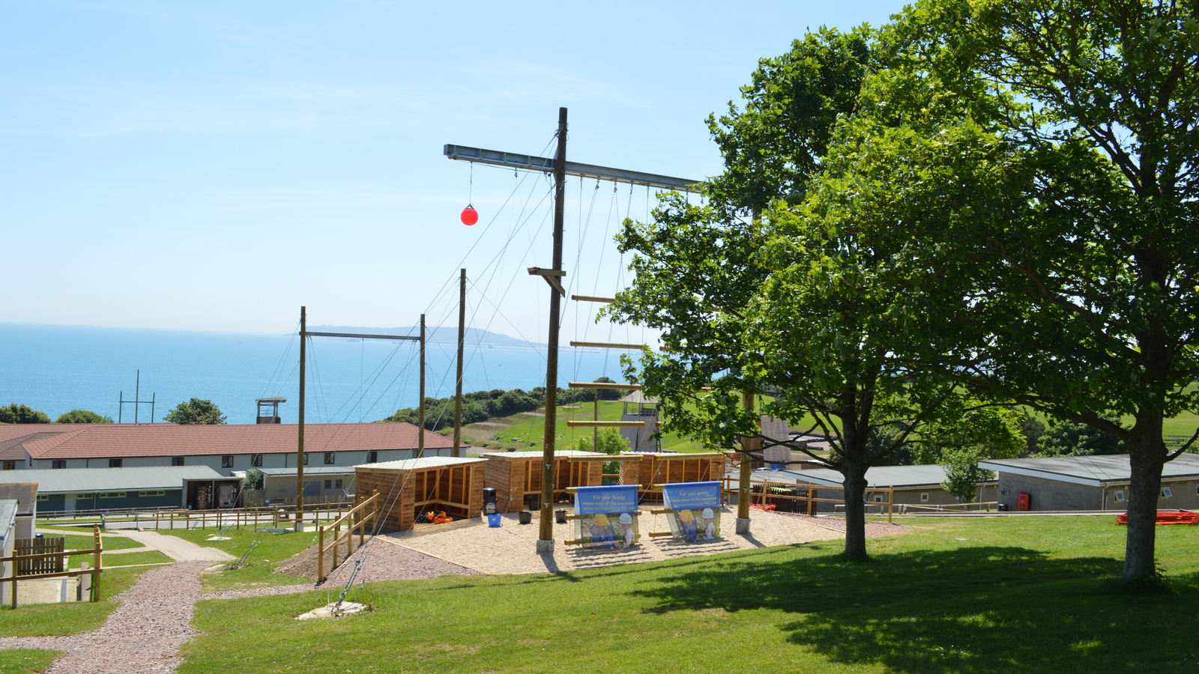
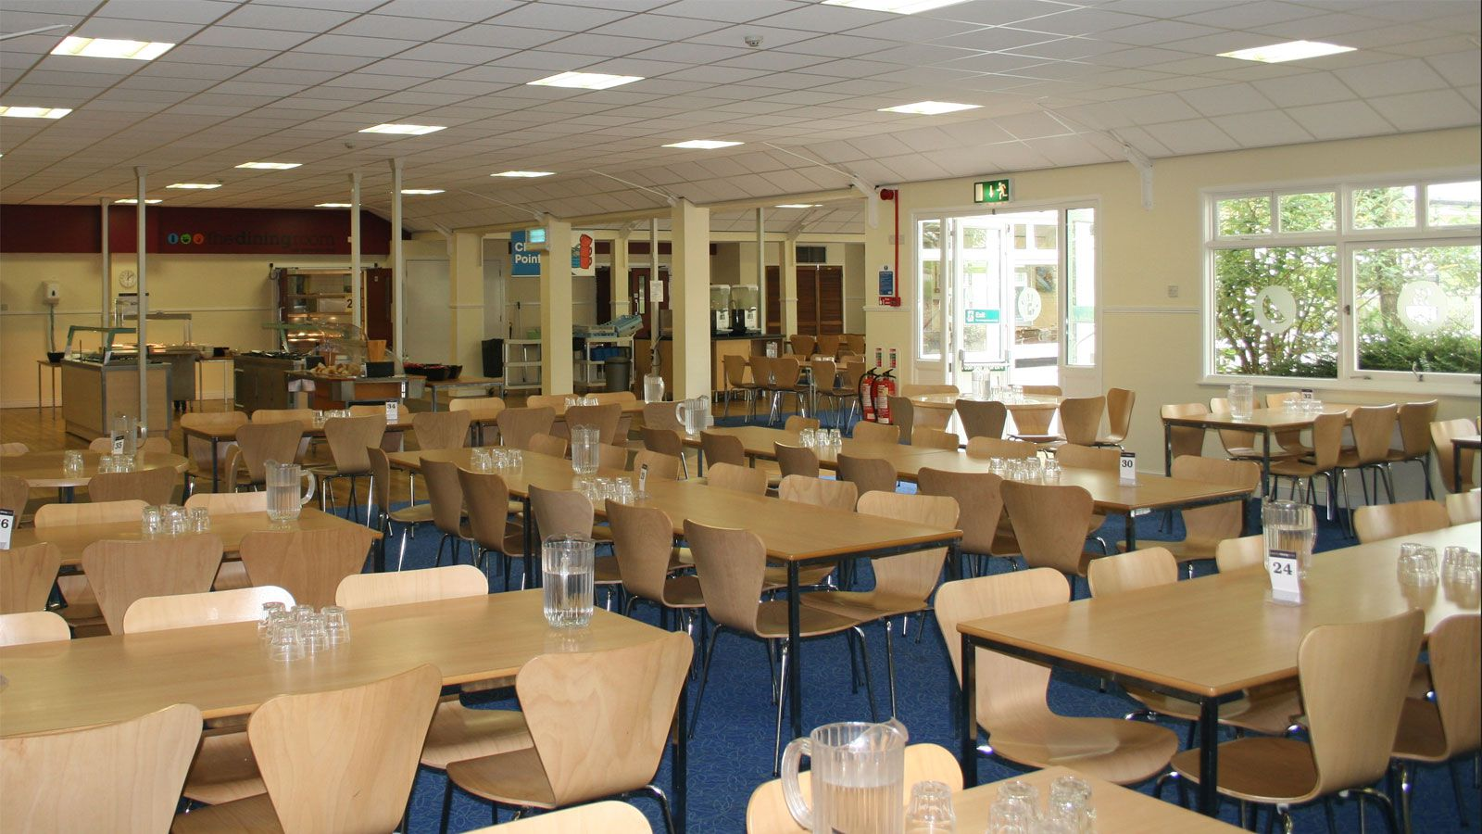
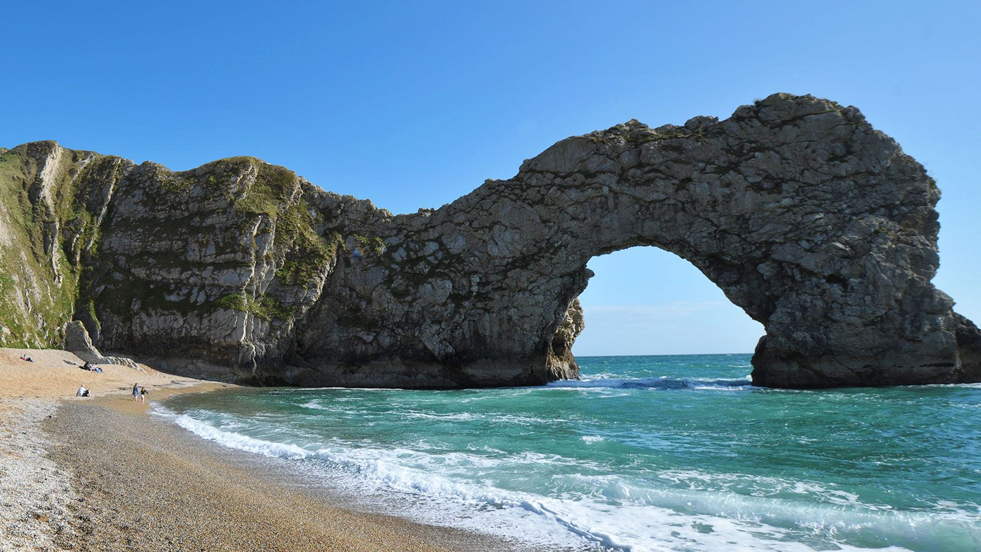
On Arrival
We will get a message to you!
Allocation of rooms and activity groups. (There will be an opportunity for children to share their preferences before we go. Please do also come and talk to us if this would be helpful).
Tour of the site, evening meal and activity.

Slide 7
Keeping in Touch During our Time Away
Mobile phones, SMART watches and electrical devices are not permitted.
Our days are really busy! We will look to share pictures with you as often as we can. From past experience this will be at least every evening and when possible lunchtime too!
If you need to get in touch, please message us through the ARBOR app or the admin email (admin@hoblettsjm.herts.sch.uk) with any concerns whilst we are away. For any emergencies the school phone number will be patched through to the PGL team out of hours (8pm-6am).

Slide 8
Coming home!
We aim to depart at 11am and will keep you updated during our return journey.
Tempting as it is to meet us off the coach, we ask that you meet us in the hall and speak with your child’s group leader before returning home together. This information will be posted in the hall for you to see.
Access once again, on foot and via Adeyfield Road.

